Slide 1
College Majors
Part Two
College Prep
Mr. Gordon
jgordon@bisdtx.org

Slide 2
Upcoming Events
Thurs. Sept. 16th Virtual 10th Grade Parent Meeting
Fri. Sept. 17th Student Council Elections
Tues. Sept. 21st Virtual 11th Grade Parent Meeting
Tues. Sept. 28th Spring Break 2023 Belize Travel Informational Meeting
hi

Slide 3

College Majors
Your college major prepares you for your career after graduation.
Your major will generally fall into one of two categories:
Bachelor of the Arts (B.A.)
Or
Bachelor of Science (B.S.)
hi

Slide 4
College Majors
The main difference between a B.A. and a B.S. degree is the classwork that is required.
The Bachelor of the Arts degree focuses on the
humanities and languages and it has typically offers more electives.
The Bachelor of Science degree focuses on
math and science.
hi

Slide 5
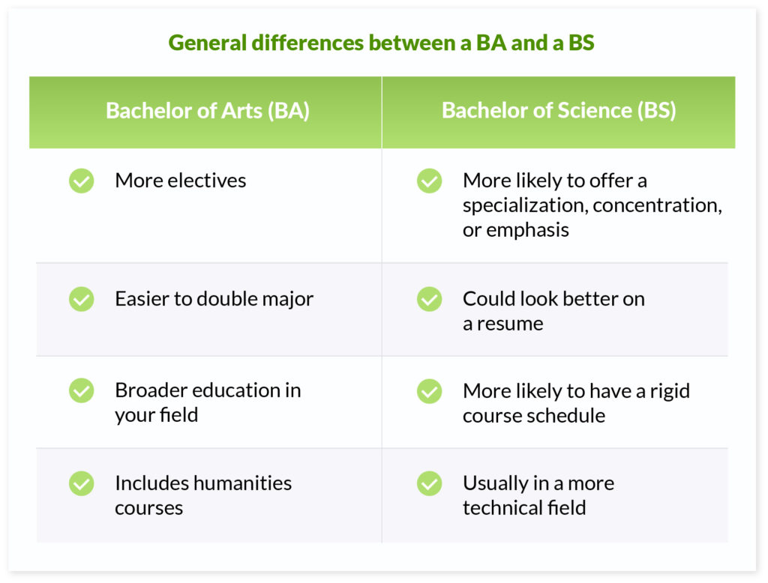
College Majors
hi

Slide 6
Common College Vocab
What’s an Elective?
A course that you choose from a list, tends to be specialized and has fewer students in the class.
For example, if you were a business major and wanted to own your own business in Asia, you could choose electives on Chinese history, entrepreneurship, or learning Japanese.
Or if you were majoring in Psychology, you could take electives based around counseling children.
hi

Slide 7

Common College Vocab
What’s a Humanity?
A humanities class or major focuses on critical thinking and creativity.
Humanities majors include history, literature, and foreign languages.
hi

Slide 8
Today’s College Prep Assignment
In the comments section of today’s College Prep,
using the three majors you chose last class, write whether they are a B.A. or B.S.
You can find this information on a college website when you Google their undergraduate majors.
What does this information tell you about your interests and your future career options?
hi

